Slide 1
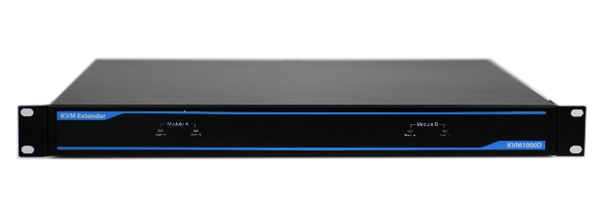
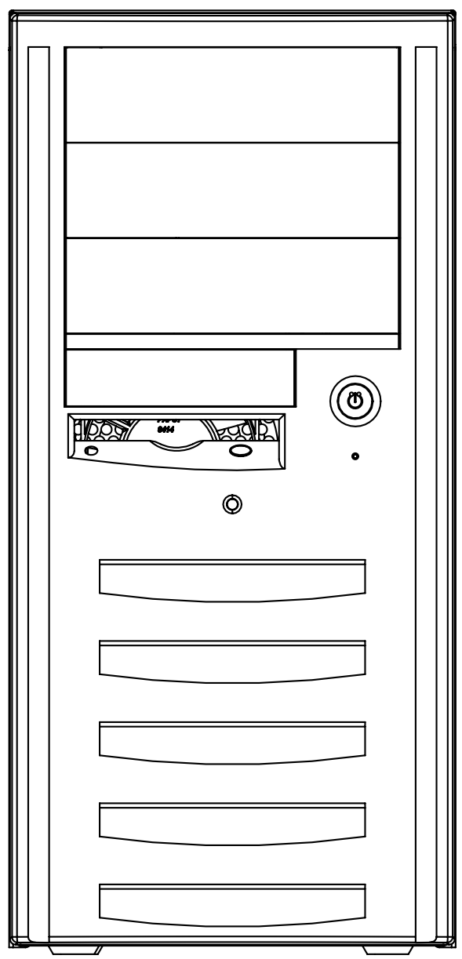
KVM1000D
Industrial-grade KVM signal long-line driver
Transmitter (TX)
Receiver (RX)
Product Features
HDMI video signal input, HDMI + VGA dual port video output | Customizable Hot Key function channel switch
KVM Extender + KVM Switch 2-in-1 Design | Excellent EMC electromagnetic compatibility performance
Support parallel cascade and daisy-chain stacking signal channel switching | Meet the use in the high altitude environment of 5500m
Product Overview KVM1000D is a KVM signal long-line driver developed for industrial automation, rail transit industry and aviation power dispatching industry. The device adopts the integrated design of extender and switcher, which can manage multiple target computers under the condition of limited number of monitos. Its core uses high-speed FPGA chip for signal acquisition and coding, and then uses single-mode & multi-mode optical fiber as the carrier to transmit high-definition audio and video and control signals (including USB-HID device, 3.5mm stereo audio and HDMI video signals ) can realize remote transmission and control within the range of 100m ~ 80KM according to optical modules with different communication distances. The minimum working unit of KVM1000D is composed of transmitter (TX) and receiver (RX). The transmitter adopts modular design and can be installed in the 19-inch standard cabinet together with the controlled target computer, which is convenient for the construction and maintenance of the machine room. The receiver is designed with a compact structure for easy installation on the remote console or in a compact space.
Transmitter (TX) Port Configuration |  |  |  |  | Receiver (RX) Port Configuration
Category | Description |  |  | Qty. | Category | Description | Qty.
HDMI Video Input | HDMI-A Male |  |  | 1 | HDMI Video Output | HDMI-A Male | 1
USB Input | USB2.0-A Socket |  |  | 1 | VGA Video Output | DB 15 Socket - Female | 1
Audio Input | 3.5mm Audio Socket |  |  | 1 | Audio Output | 3.5mm Audio Socket | 1
Fiber Interface | SFP Socket, Optional SC or LC (single and dual fiber) optical module |  |  | 1 | USB Output | USB2.0-A socket (HID device only) | 2
Condition Monitoring | DB9-pin socket (RS-232 protocol) (optional, not on by default) |  |  | 1 | Fiber Interface | SFP Socket, Optional SC or LC (single and dual fiber) optical module | 1
Channel Status | A&B channel status indicator (green) |  |  | 2 | Parallel Port | RJ45 Socket | 2
/ |  |  |  |  | Desktop Switching | 3.5mm Audio Socket (Female) | 1
/ |  |  |  |  | Channel Switch | Manual micro-touch button switch | 1
Dimensions | 435*360*44.4mm （W*D*H） |  |  |  | Dimensions | 210*206*44.4mm （W*D*H）
Power Supply | C13 Socket, AC Input 110VAC/220V AC±20%, 47-63Hz
Environmental Parameters
Operating Temperature | -25~60℃ | Storage Temperature | -40~80℃ |  | Vibration Shock | IEC 60068-2-6 1Grms
Humidity | 5~95%@45℃ non-condensing | Altitude | ≤5500m |  | MTBF | ≥100000H
Product Certification | CE,FCC,IC,PSE,UKCA,RoHS
应用场景：4路显示输入，2路显示输出
HDMI A1
HDMI A2
USB-HID
HDMI &VGA(1)
AUDIO
KVM1000D-TX
20km optical fiber
KVM1000D-RX
HDMI &VGA(2)
HDMI B1
USB-HID
HDMI B2
AUDIO
USB-HID
AUDIO
Control Center
Equipment Room
For more product solutions, please call: 400-678-1199

Slide 2
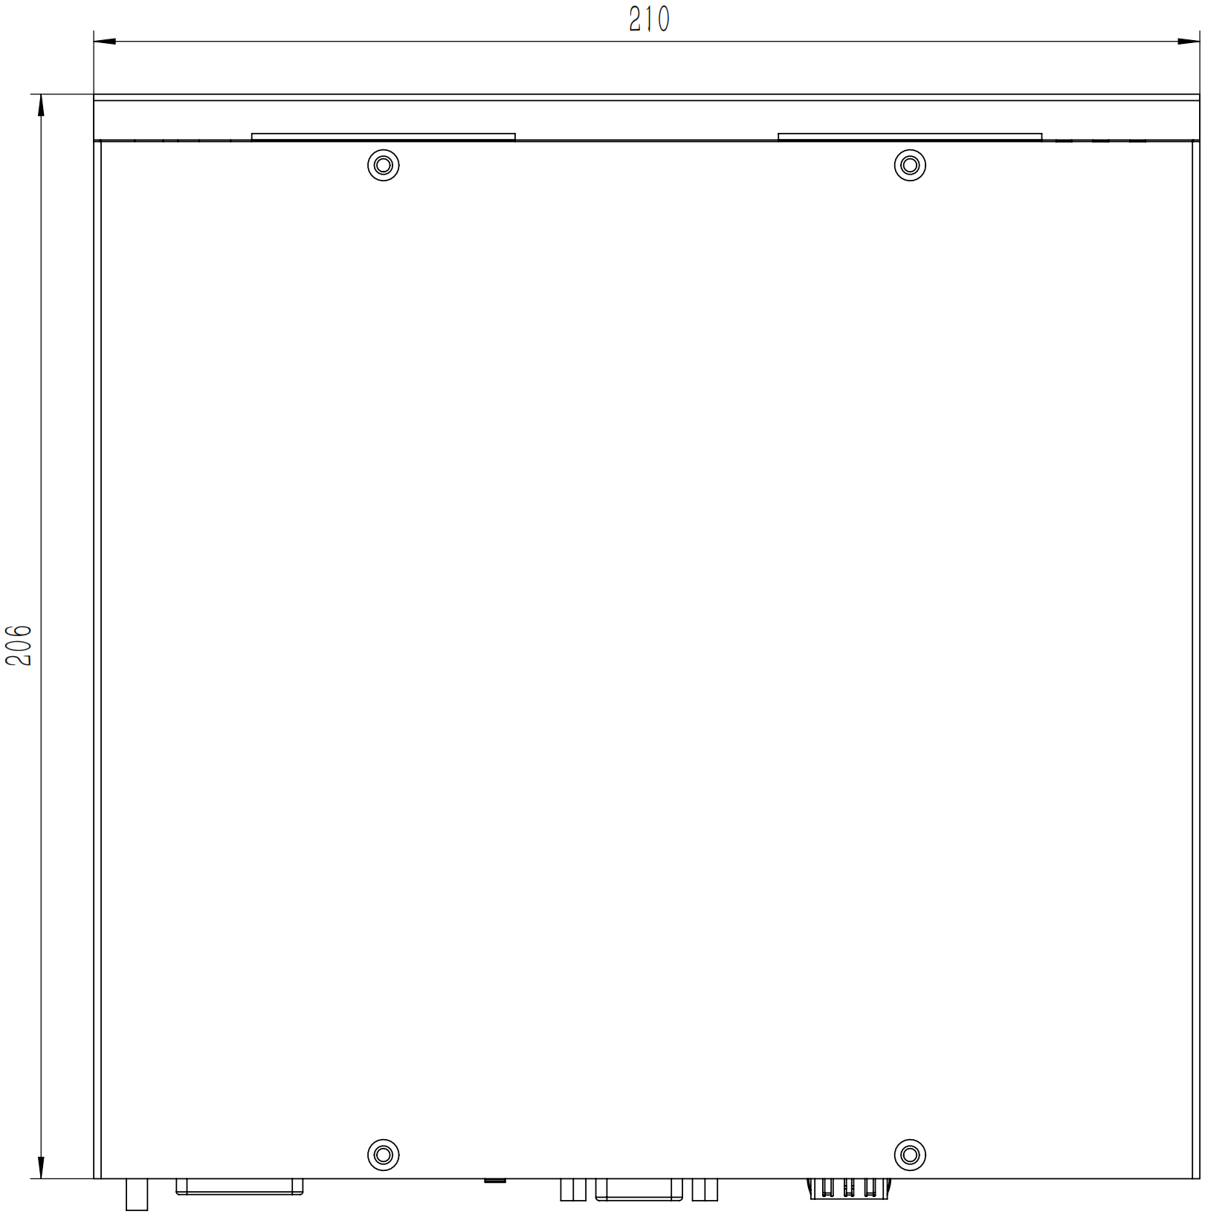
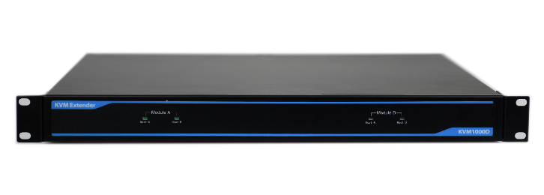
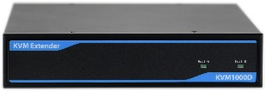
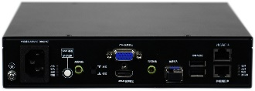
KVM1000D
Industrial-grade KVM signal long-line driver
Structure Size Unit: mm
Transmitter (TX) Front View
Receiver (RX) Front View
Transmitter (TX) Rear View
Receiver (RX) Rear View
Order Information: (Single-mode LC port optical module is configured by default)
Product Model | Material Number | Configuration | Fiber Interface | Optical Fiber Type | Extended Distance | Optical Fiber Requirement
KVM1000D （Single） | M20221003 | Two-in-one-out configuration: 1U transmitter built-in functional module * 1, Receiver * 1, preset EDID, Maximum video resolution 1920 * 1200, Transmitter with 2-channel HDMI video input (internal switching function) Receiver VGA + HDMI dual display (copy) output, support USB-HID peripherals, AC input | SC & LC Single fiber bidirectional | Single mode & Multi-mode | 500m~40km Optional | OM4
Accessories List | HDMI-HDMI video (Type A) * 2, USB-USB Type A data cable * 2, 3.5mm audio signal cable (male) * 2, National standard C13 plug power cord * 2, Product use manual * 1, Qualified certificate * 1, Device Functional Conformance Checklist * 1, 2.5mm² WDZB-RYJ yellow-green grounding wire * 2, LC-LC single-mode optical fiber jumper * 1
KVM1000D （Dual） | M20221004 | Four-in-two-out configuration: 1U transmitter built-in functional module * 2, Receiver*2, preset EDID, Maximum video resolution 1920 * 1200, Transmitter with 4-channel HDMI video input (internal switching function), Receiver VGA + HDMI dual display (copy) output, Support USB-HID peripherals, AC input | SC & LC Single fiber bidirectional | Single mode & Multi-mode | 500m~40km Optional | OM4
Accessories List | HDMI-HDMI video (Type A) * 4, USB-USB Type A data cable * 2, 3.5mm audio signal cable (male) * 2，National standard C13 plug power cord * 4, Product use manual * 1, Qualified certificate * 1, Device Functional Conformance Checklist * 1, 2.5mm² WDZB-RYJ yellow-green grounding wire * 3，LC-LC single-mode optical fiber jumper * 2, RJ45 parallel cable * 1
For more product solutions, please call: 400-678-1199

Slide 3
KVM1000D
工业级KVM信号长线驱动器
结构尺寸 单位：mm
发射机（TX）正面视图
接收机（RX）正面视图
发射机（TX）背面视图
接收机（RX）背面视图
订购信息：（默认配置单模LC端口光模块）
产品型号 | 物料号 | 配置 | 光纤接口 | 光纤类型 | 延长距离 | 光纤要求
KVM1000D（单） | M20221003 | 二进一出配置：1U发射机内置功能模块*1，接收机*1, 预置EDID，最大视频分辨率1920*1200，发射机具备2路HDMI视频输入（内部切换功能）接收机VGA+HDMI双显（复制）输出，支持USB-HID外设，交流输入. | SC &LC 单纤双向 | 单模&多模 | 500米~40KM可选 | OM4
附件清单 | HDMI-HDMI视频（A型）*2，USB-USB A型数据线*2，3.5mm 音频信号线（公头）*2，国标C13插头电源线*2，产品使用说明书*1，合格证*1，整机一致性出厂检验单*1，2.5mm² WDZB-RYJ黄绿接地线*2，LC-LC单模光纤跳线*1
KVM1000D（双） | M20221004 | 四进二出配置：1U发射机内置功能模块*2，接收机*2, 预置EDID，最大视频分辨率1920*1200，发射机具备4路HDMI视频输入（内部切换功能），接收机VGA+HDMI双显（复制）输出，支持USB-HID外设，交流输入. | SC &LC 单纤双向 | 单模&多模 | 500米~40KM可选 | OM4
附件清单 | HDMI-HDMI视频（A型）*4，USB-USB A型数据线*2，3.5mm 音频信号线（公头）*2，国标C13插头电源线*4，产品使用说明书*1，合格证*1，整机一致性出厂检验单*1，2.5mm² WDZB-RYJ黄绿接地线*3，LC-LC单模光纤跳线*2,RJ45并机线*1
更多产品解决方案请致电：400-678-1199

